Slide 1
CMM262/BGGN237
Module 1: RNA-sequencing
Ryan Marina
01/09/2018

Slide 2
Outline
Intro to RNA-seq
Processing pipeline and workflow
Intro to Triton Shared Computing Cluster (TSCC)

Slide 3
RNA-seq Pipeline
RNA Isolation and Fragmentation
Library Preparation
Sequencing
Genomic Alignment of Sequencing Reads

Slide 4
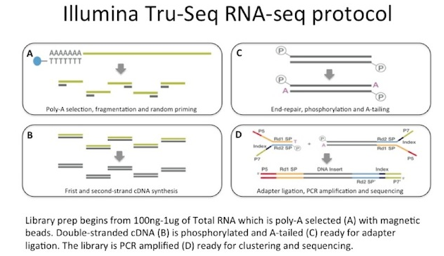
General Library Preparation

Slide 5
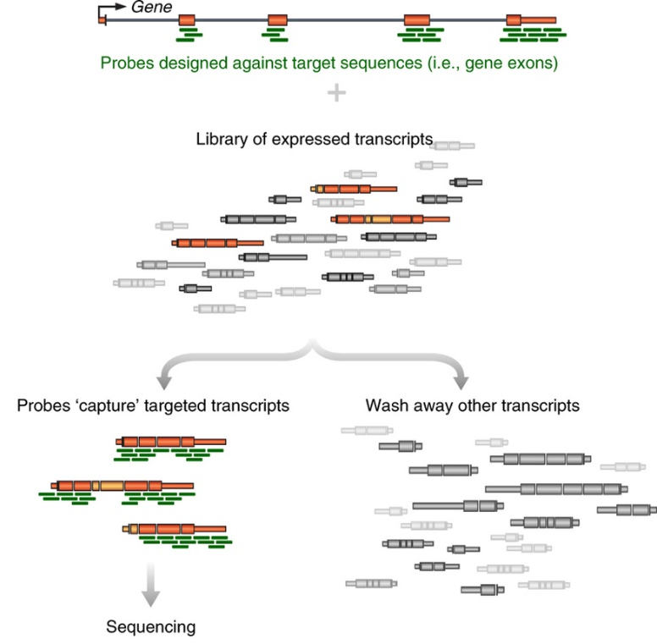
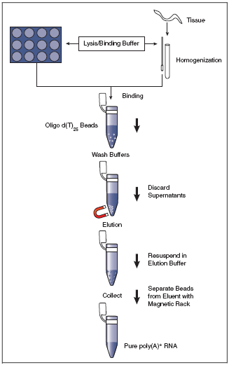
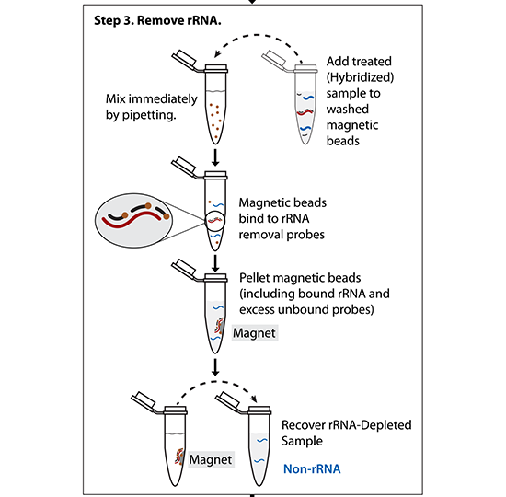
Step 1: What RNA do you want to profile?
mRNA only -> PolyA selection
rRNA-depleted RNAs -> rRNA negative selection
Specific RNAs -> targeted enrichment
(All mRNAs are polyadenylated at the 3’ end – can use d(T)₂₅ beads to select)
(Probes matching rRNA are used to pull-out rRNA molecules)
(Other methods – hybridize targeted DNA oligos + RNAseH treat)

Slide 6
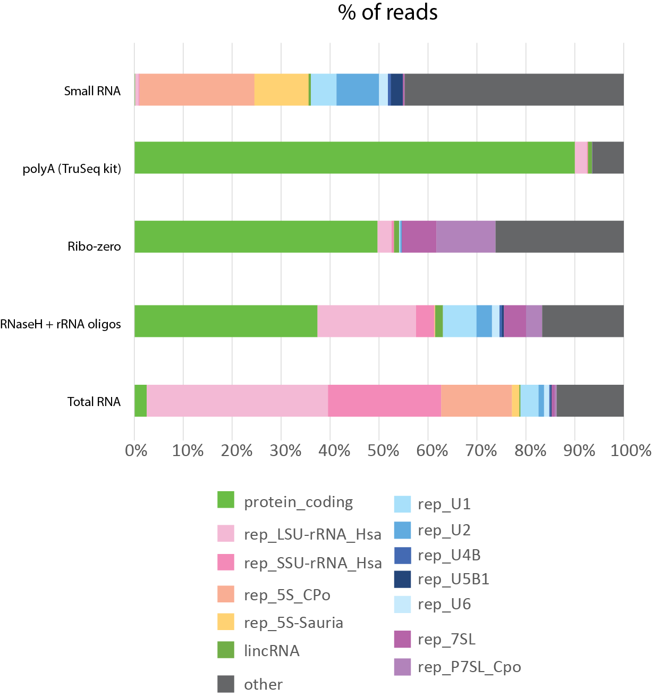
Step 1: What RNA do you want to profile?
Preparation method greatly impacts the over profile of your library

Slide 7
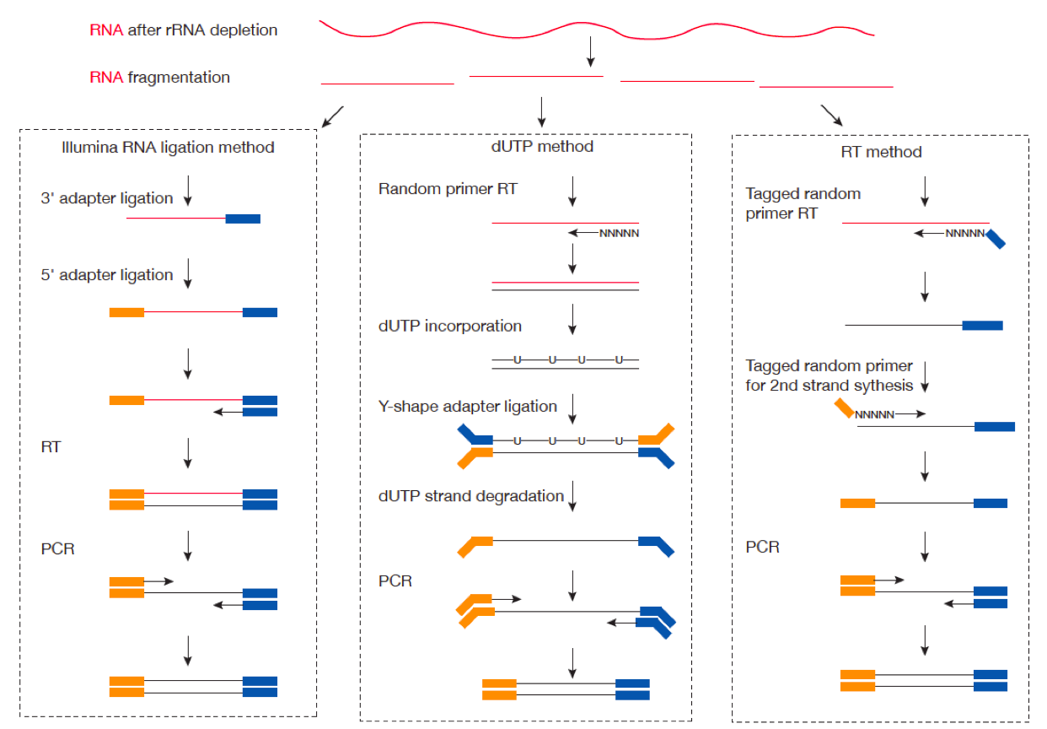
Step 2: How do you preserve strand information throughout RT?

Slide 8
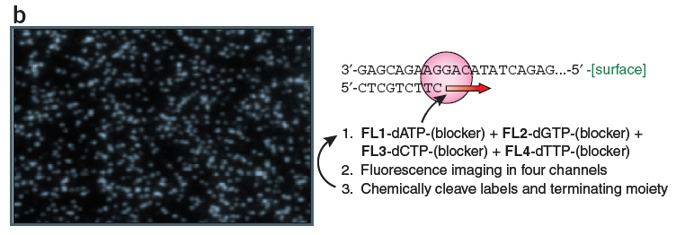
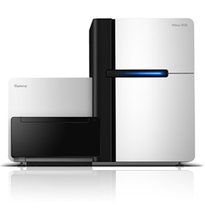
Sequencing by synthesis: HiSeq 2500 (Illumina)
Shendure & Lee, Nat. Biotech. 2008
Can do 50bp to 250bp single-end or paired-end reads
~300 million reads per lane x (2 or 8) lanes
4-8 days run time
200 billion bp output each run
Notes:
8

Slide 9
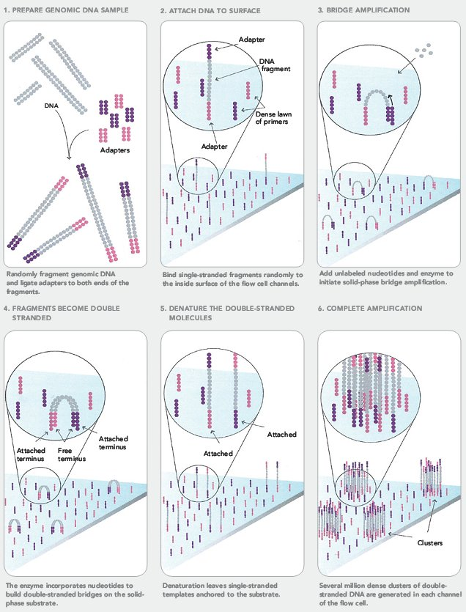
Cluster Formation on Illumina Flowcell

Slide 10
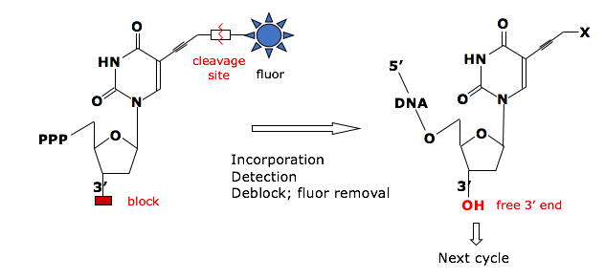
Sequencing by Synthesis
Reversible Terminator Chemistry
3’-
…-5’
5’-
G
T
A
T
T
T
T
C
G
G
C
A
C
A
G
A
G
A
C
T
T
C
T
G
Cycle 1: Add sequencing reagents
First base incorporated
Remove unincorporated bases
Detect signal
Cycle 2-n: Add sequencing reagents and repeat

Slide 11
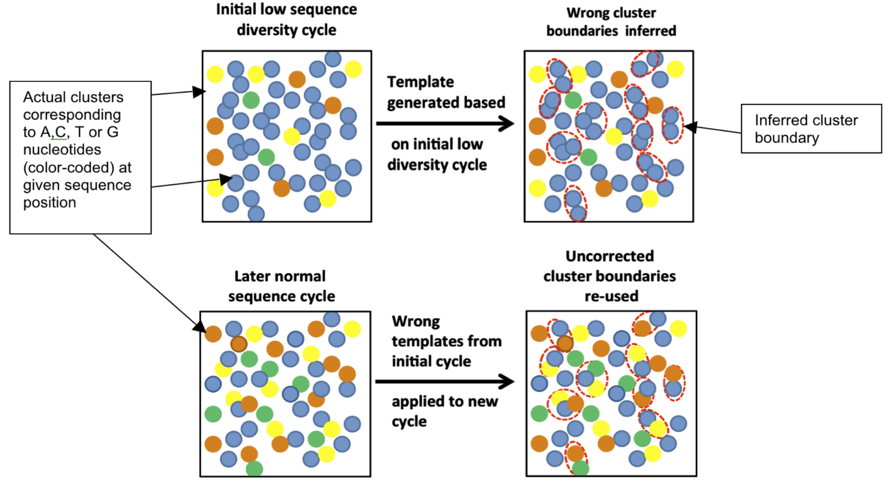
Key considerations
“Cluster Density” = how many clusters are there per mm²
If too high, hard to properly draw cluster boundaries
“Library Complexity” = how diverse are the sequences?
Illumina identifies clusters in the first 5 cycles – if those 5 cycles are identical for nearby clusters, the software doesn’t know to split them into two
Mitra, A. et al. Plos ONE (2015)
Notes:
How can you solve a problem like this?
Decrease cluster density – works, but lose sequencing power
Artificially add complexity
Spike in other libraries
Add random-mers

Slide 12
HiSeq 4000
Patterned flow cell with nanowells
Only 1 cluster per nanowell
Explicitly defines cluster density
Increased throughput:
400 million reads per lane x 8 lanes

Slide 13
Illumina sequencing – fragment strategy
I5 adapter
Read1 primer
DNA insert (your library)
Read2* primer
I7 adapter
Flow Cell Surface
I5 index*
I7 index*
* optional
Reaction #
Flow Cell Surface
1
Read1 primer
Read1 sequence
Flow Cell Surface
2*
Index1 primer
Index1 sequence

Slide 14
Illumina sequencing – Paired End & Dual Indexing
Reaction #
Flow Cell Surface
1
Read1 primer
Read1 sequence
Flow Cell Surface
2*
Index1 primer
Index1
(I7) sequence
Flow Cell Surface
3*
Index2 primer
Index2
(I5) sequence
Flow Cell Surface
4*
Read2 primer
Read2
sequence
* optional

Slide 15
Paired-end sequencing results in more accurate sequence alignment

Slide 16
RNA-Seq Analysis Overview:
Download Data
(fastq)
Check Quality (fastqc)
Align to Genome (STAR)
Sort and Index BAM (samtools)
Count Reads Mapped to Genes (featureCounts)
Differential Expression (DESeq2)
Interesting Biology!

Slide 17
Fastq File
First line is the information about the location of the read and specific sequencing machine used:
Second line is the nucleotide sequence called
Third line is “+” and can optionally be followed by a repeat of the filename in line 1
Fourth line contains the quality score as determined by the sequencer
@NS500672:54:HL775BGXX:1:11101:22716:1042 1:N:0:CCCCGG
CCGCCNATGCCCATGCCACAGTTGTTGAGCTTGAGTTCCTGCAGGGTGAAGCAGGCTGAGCTCTTGAGCAGGGCCTCGAA
+
AAAAA#EEEEEEEEEEEEEEEEEEEEEEEEEEEEEEEEEEEEEEEEEEEEEEEEEAEEEEEEEEEEEEEEEEEEEEEEEE
Notes:
Four lines represent 1 read off the machine

Slide 18
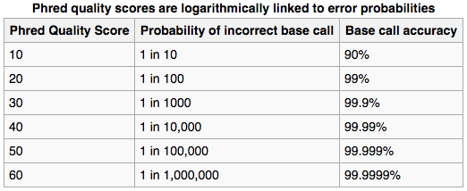
Fastq File – Phred Quality Score
Quality scores report the probability that the base call is incorrect
Field standard is to accept bases with quality >20
Notes:
Four lines represent 1 read off the machine
Quality scores have been converted into the ascii code for reporting… not important here

Slide 19
Illumina sequencing – great for read #, not great for read length
Quality score
0
100
200
300
400
Cycle #

Slide 20
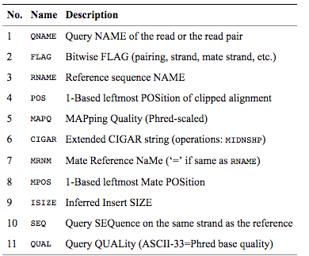
SAM/BAM File
BAM files are binary, you must use samtools to view them
Bioinformatics. 2009 Aug 15;25(16):2078-9. Epub 2009 Jun 8. The Sequence Alignment/Map format and SAMtools.
Notes:
Four lines represent 1 read off the machine

Slide 21
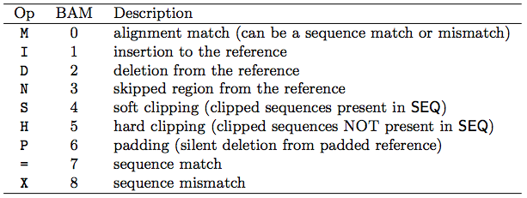
Concise Idiosyncratic Gapped Alignment Report (CIGAR) String
Contains specific information about the mapping information at specific positions across the read
Bioinformatics. 2009 Aug 15;25(16):2078-9. Epub 2009 Jun 8. The Sequence Alignment/Map format and SAMtools.

Slide 22

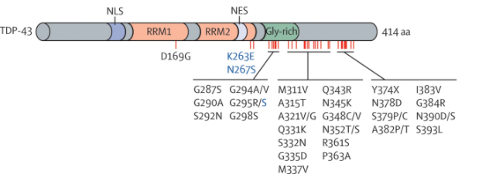
Experiment: TARDBP shRNA from ENCODE
TARDBP/TDP-43:
DNA and RNA-binding protein regulating transcription and alternative splicing
Aberrantly processed forms of TARDP miseggregate to cytoplasm and re associated with neurodegenerative diseases (FTLD, ALS)
Dataset: What are the transcriptional consequences of TARDBP depletion?
https://www.encodeproject.org/rna-seq/long-rnas/
Each replicate should have 30 million aligned reads, although older projects aimed for 20 million reads.
Replicate concordance: the gene level quantification should have a Spearman correlation of >0.9 between isogenic replicates and >0.8 between anisogenic replicates (i.e. replicates from different donors).
Notes:
The Encyclopedia of DNA Elements (ENCODE) is a public research project launched by the US National Human Genome Research Institute (NHGRI) in September 2003. Intended as a follow-up to the Human Genome Project (Genomic Research), the ENCODE project aims to identify all functional elements in the human genome.

Slide 23
RNA-Seq Analysis Overview:
Download Data
(fastq)
Check Quality (fastqc)
Align to Genome (STAR)
Sort and Index BAM (samtools)
Count Reads Mapped to Genes (featureCounts)
Differential Expression (DESeq2)
Interesting Biology!

Slide 24
Introduction to TSCC

Slide 25
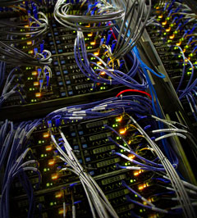
TSCC
Triton Shared Computing Cluster (TSCC)
Housed within the San Diego Supercomputer Center (SDSC)
Other clusters include Comet and Gordon
More information about TSCC:
http://www.sdsc.edu/support/user_guides/tscc-quick-start.html
sdsc.edu

Slide 26
What is the file structure of TSCC?
Projects
Scratch
/projects/ps-yeolab
/projects
/oasis/tscc/scratch/username
/projects/chi-group
/home
/home/ecwheele
/home/ucsd-train01
/home/olgabot
Home

Slide 27
TSCC Structure: Branches from Root
Scratch – Faster file processing, runs on a parallel file system
Each user is given their own directory in scratch
Essentially unlimited space, but untouched files get purged after 3 months
https://en.wikipedia.org/wiki/Lustre_(file_system)
Home – Permanent storage for each user, small space, runs on network file system
Each user has their own home folder
Very minimal space
https://en.wikipedia.org/wiki/Network_File_System
Projects – Labs purchase storage space for permanent files that are shared among members of the lab
Each lab has their own projects folder this is space for more permanent storage (e.g. ps-yeolab)

Slide 28
Submitting a Job to TSCC
For tasks that require large amounts of processing power, you can submit a job to the TSCC computing cluster
Submitting a job allows the user to request the specific number of compute nodes and processors per node needed for you job
The submitted job goes into the designated queue and will be run when the requested number of processors becomes available

Slide 29
TSCC Job Queues
TORQUE Resource Manager manages job queues
Queues include:
hotel: supports all non-contributors to TSCC; this is the only node we are eligible to use
home: clusters reserved for members of particular group; purchased
condo: will allow contributors to run on nodes greater than those that have already been purchased; 8-hour time limit
glean: allows to run jobs, free-of-charge, on available idle nodes within condo; jobs will be terminated if idle nodes are requested
One or more job may be submitted simultaneously

Slide 30
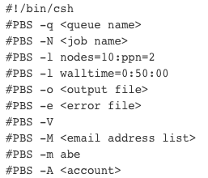
Submitting Jobs to TSCC using shell scripts
Designed to be run on a Unix shell, command-line interpreter
First line describes language to be used:
We will submit jobs using bash scripting:
#!/bin/bash
PBS flags (#PBS) will be used to describe parameters of your job submission

Slide 31
Submitting Jobs to TSCC using shell scripts
Example of a submission script:
#!/bin/bash
#PBS -N star_genomegenerate
#PBS -o star_genomegenerate.sh.out
#PBS -e star_genomegenerate.sh.err
#PBS -l walltime=8:00:00
#PBS -l nodes=1:ppn=8
#PBS -q hotel
More information about submission parameters:
http://www.sdsc.edu/support/user_guides/tscc-quick-start.html

Slide 32
Checking the status of a submitted job
qstat – u <username>
Example: qstat –u ecwheele
Q – job is in the queue to be run
R – Job is running
C – Job is complete
To delete a job:
qdel <jobid#>
You can find the jobid# from qstat
Note – After your job has completed, the “C” will only be there for a few minutes. If the job has disappeared completely then it has finished running and you can find information about how it ran in your output files.

Slide 33
Submitting an Interactive Job
If you want to be able to interact with the command line while taking advantage of the compute power available on TSCC, you can submit an interactive job
The job will be open for as long as the walltime specifies, and you will be operating on the number of nodes and processors requested
Example:
qsub –I –q hotel –l nodes=1:ppn=4 –l walltime=01:00:00

